Slide 1

Public finance analysis
BY GROUP 5
SHAMITA SHETTY
DEEPTI JAGANNATH MEHER
SHOHINI ROY
MAYUR GUNJAL
HAVEESH KH

Slide 2
INTRODUCTION
The government of every country has to perform certain special functions which can be classified under two heads
Obligatory functions
Optional functions
To perform all these functions adequately and efficiently government needs fund from the public.

Slide 3
Meaning of public finance
The study of public finance as a branch of economic has come to occupy a very important place in economic literature since last nine decades.
Public finance is that science which deals with the income and expenditure of the public authorities.
The word public authorities include all sorts of government.

Slide 4
PUBLIC FINANCE ANALYSIS
Public finance involves the study of government revenue(receipts) and expenditure.
Government expenditure
Current expenditure-Includes spending on goods and services that are consumed within the current year, and which need to be made recurrently. Examples include salaries of public servants, social security payments, and subsidies.
Capital expenditure-Involves spending on assets that will last for more than a year, such as infrastructure projects(roads, schools, hospitals)and investments in research and development.
Transfer payments- payments made without any exchange of goods or services, such as unemployment benefits and pensions
Interest payments-accounts for 20%, the single largest component of the Centre’s total expenditure. Payments made to service the national debt.

Slide 5

SOURCES OF GOVERNMENT RECEIPTS
The sources by which a government earns income are classified into two categories.
Tax revenue
Non tax revenue

Slide 6

TAX REVENUE
Tax revenue is the income that is gained by government through taxation
Taxes are compulsory contribution levied by the state for meeting expenses in the common interest of all citizens.
Tax revenue can be classified into:
Direct taxes (e.g.: income tax, wealth tax)
Indirect taxes (e.g.: sales tax)

Slide 7
NON-TAX REVENUE
Non -tax revenue sources of public revenue which are raised by the government from other than tax in the economy .some non-tax revenues:-
Administrative revenues- fees, special assessments, fines and penalties, forfeitures.
Commercial revenues- Income earned by the government by engaging in commercial activity. e.g. railways, post, public sector industries etc..
Other revenues- gifts, grants, donations, government properties, public borrowings, recovery of loans etc..

Slide 8

HIGHLIGHTS OF UNION BUDGET 2024-2025
The key features of the Budget for 2024-2025, focusing on various sectors and initiatives aimed at economic development and social welfare.
Productivity and Resilience in Agriculture: ​
Emphasis on transforming agriculture research, promoting natural farming, and supporting shrimp production and export.
Introduction of Digital Public Infrastructure for farmers and issuance of Jan Samarth based Kisan Credit Cards. ​
Employment & Skilling:
Various schemes introduced to incentivize employment, skill development, and support for higher education.
Plans to skill 20 lakh youth over a 5-year period and upgrade Industrial Training Institutes. ​
Inclusive Human Resource Development and Social Justice:
Initiatives like Purvodaya for economic opportunities in Eastern states and schemes benefiting women and tribal communities.
Manufacturing & Services:
Focus on industrial parks, internship opportunities, credit support for MSMEs, and infrastructure development under various corridors.

Slide 9
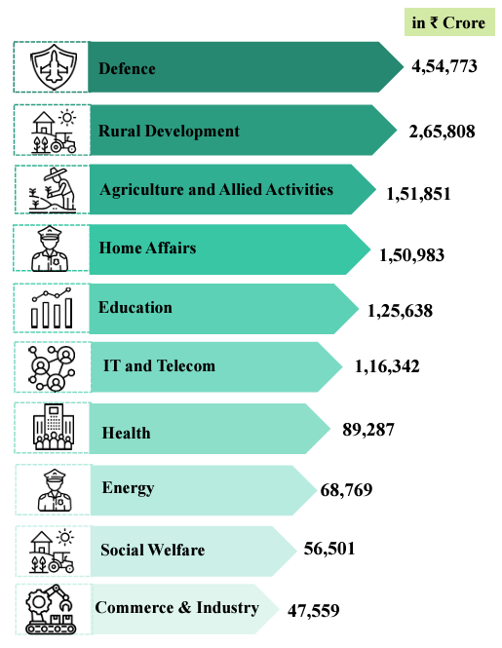
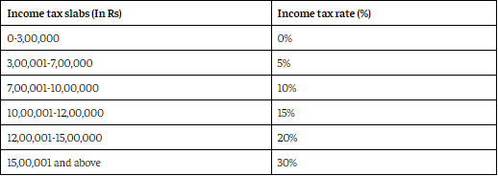
Urban Development:
Plans for stamp duty reduction, transit-oriented development, and encouraging street markets for urban growth. ​
Energy Security:
Initiatives in nuclear energy, energy audit, pumped storage policy, and schemes like PM Surya Ghar Muft Bijli Yojana.
Infrastructure:
Allocation of funds for infrastructure development, including rural connectivity and irrigation projects.
Tax Proposals:
Simplification in taxes, sector-specific customs duty proposals, and direct tax proposals to reduce compliance burden and promote investment. ​
Expenditure of Major Items: ​
Allocation of funds to various sectors like Defence, Rural Development, Agriculture, Home Affairs, Education, IT, Health, Energy, Social Welfare, and Commerce & Industry

Slide 10
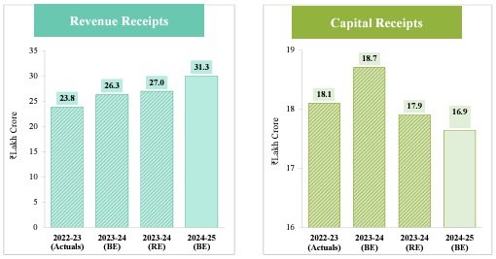
Receipts and Expenditure: ​
Details on revenue receipts, capital receipts for the specified years.

Slide 11
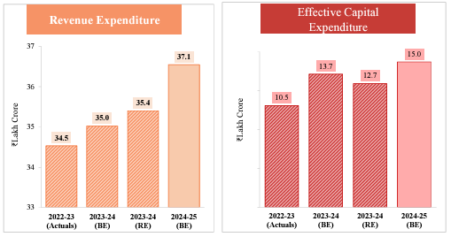
Revenue expenditure, and effective Capital expenditure for the specified years.

Slide 12
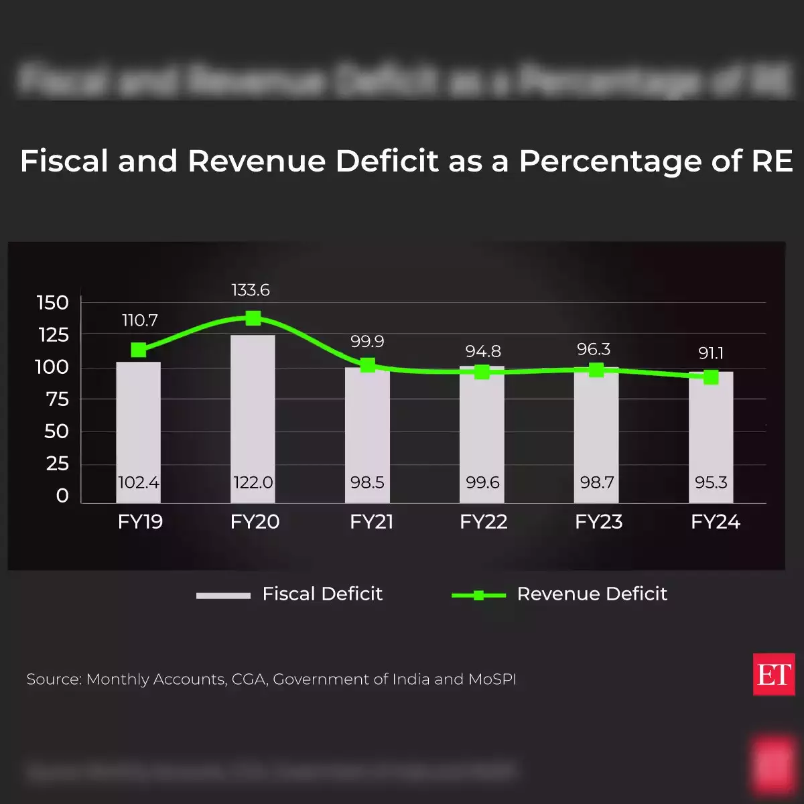
FISCAL DEFICIT:-
Fiscal Deficit Formula: The fiscal deficit can be calculated using the formula:
Fiscal Deficit=Total Expenditures−Total Revenues.
Implications:
Inflation: Financing a deficit by printing money can lead to inflation
Crowding Out: Increased government borrowing can lead to higher interest rates.
Government Borrowing: Governments often need to borrow money by issuing bonds or taking loans.

Slide 13
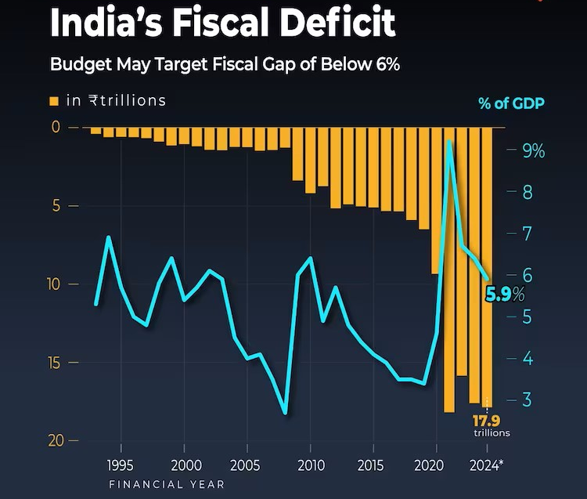
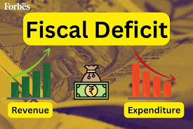

Slide 14

Future Trends
Increased Use of Big Data and Analytics:
Trend: Governments are increasingly adopting data analytics tools to refine budget forecasts and spending.
Data: According to a survey by Deloitte, 59% of public sector organizations reported using data analytics to guide policy decisions, with expectations of growth in this area.
Focus on Sustainability and Green Finance:
Trend: Governments are increasing investments in sustainable projects to address climate concerns.
Data: The Climate Policy Initiative reported that global investment in climate finance reached about $632 billion in 2022, showing a significant increase in green projects funded by public finance.
Behavioral Insights and Public Policy:
Trend: Behavioral economics is being integrated into public finance for better compliance and policy design.
Data: According to the Behavioral Insights Team, countries that have applied behavioral insights to tax compliance have seen increased tax revenues by up to 15%.
Digital Currency and Payment Systems:
Trend: Governments are exploring or adopting digital currencies (CBDCs) for fiscal operations.
Data: A Bank for International Settlements report indicated that 86% of central banks were researching CBDCs, with several exploring their effects on public finance, especially for tax collection and social welfare distribution.

Slide 15

Public-Private Partnerships (PPPs):
Trend: The utilization of PPPs for infrastructure and public service delivery is on the rise.
Data: The World Economic Forum reported that global PPP investments reached $77 billion emphasizing a critical trend towards leveraging private sector efficiency in delivering public goods
Globalization and International Cooperation:
Trend: Increased international collaboration to tackle tax avoidance and improve tax administration.
Data: OECD’s Base Erosion and Profit Shifting (BEPS) initiative has been endorsed by 141 countries, indicating a collective effort to reform international tax standards
Digital Transformation of Government Services
Digital technologies are transforming how governments deliver service.
According to a McKinsey study, governments that digitized public services were able to provide services 60% faster while reducing operational costs by around 30%.

Slide 16
Conclusion
Budget 2024-2025 promotes economic development and social welfare.​
Focus on agriculture, employment, skilling, and human resource development drives productivity ​
Emphasis on digital infrastructure, industrial growth, and energy security boosts economic growth​
Allocation of funds to key sectors (infrastructure, education, healthcare) ensures inclusive development​
Initiatives benefit citizens across the country, setting the stage for a prosperous future​
Fiscal deficit risks (inflation, crowding out, increased borrowing) must be managed​
Understanding these concepts is essential for informed decision-making and fiscal responsibility

